Slide 1





Final project Group 3
Superstore sales

Slide 2









Team Members
Osama Fathy
Abdelrahman
Shaban
Mahmoud Reda
Mohamed Tiba
Ebrahim Mohamed
Mahmoud Mohamed
Under Supervision
Eng. Soha Nagi
Prepared by
Group 3

Slide 3

PPT下载 http://www.1ppt.com/xiazai/
Contents
01
02
03
04
05
06
07
08
Introduction
Objective
Data
overview
Used
tools
Data
cleaning
Dashboard
Data processing
&insights
conclusion

Slide 4

01
Introduction
Notes:
模板来自于：第一PPT https://www.1ppt.com/

Slide 5


Introduction
Superstore is a small retail business located in the United States. They sell Furniture, Office Supplies and Technology products and their customers are the mass Consumer, Corporate and Home Offices.
The data set contains information about customer names ,orders , sales and geographical regions of Superstore.

Slide 6
02
Objective
Notes:
模板来自于：第一PPT https://www.1ppt.com/

Slide 7


Objective
The store want to analyze the data to know :
Is business growing or not ?
Overall sales evaluation & Sales change over the years.
Evaluation of sales among product categories , regions and states , customers and segments , and different shipping classes ?
If there is any clear problems affect the business and any recommendation depending on analyzing the data to enhance the business ?
Notes:
Fluctuations= تذبذب

Slide 8
03
Dataset Overview
Notes:
模板来自于：第一PPT https://www.1ppt.com/

Slide 9

Dataset Overview
This dataset includes sales records from a Superstore, covering multiple product categories and geographic regions. It spans four years of daily sales data.
The number of records was approximately (9800) records.
Time frame: 2015–2018
Size: 18 columns
Key Columns :
Order ID, Row ID – Transaction tracking
Order Date – Date of transaction
Ship Date – Shipping fulfillment date
Ship Mode – Shipping method
Customer ID, Customer Name – Customer identifiers
Segment – Market segment (e.g., Consumer, Corporate)
Country , state , City , region – Geographic segmentation
Postal Code – Zip/postal identifier
Product ID, Product Name – Specific product detail
Category, Sub-Category – Product classification
Sales – Revenue from each order
Ship duration – time of shipping

Slide 10
04
Used tools
Notes:
模板来自于：第一PPT https://www.1ppt.com/

Slide 11

Data cleaning
Excel
Data visualization
Tableau

Slide 12
05
Data cleaning
Notes:
模板来自于：第一PPT https://www.1ppt.com/

Slide 13

Data cleaning
Duplication checked >> no duplication
2. Null values checked >> 11 null value in postal code column
11 value for Burlington city only
#Missed Postal code checked online and null values replaced by postal code
3. Standardization of each column data format type
#Converting dates in (order date& ship date ) columns
4. Adding column (Ship duration) to track shipping criteria
#substracting order date from shipping date

Slide 14
06
Dashboard
Notes:
模板来自于：第一PPT https://www.1ppt.com/

Slide 15
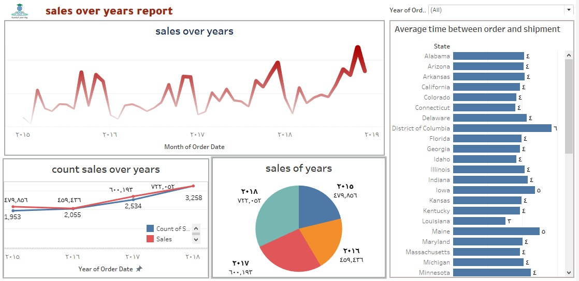
Dashboard Sales Over Years By Mohamed Tiba

Slide 16
07
Data processing &insights
Notes:
模板来自于：第一PPT https://www.1ppt.com/

Slide 17
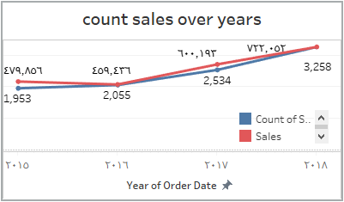
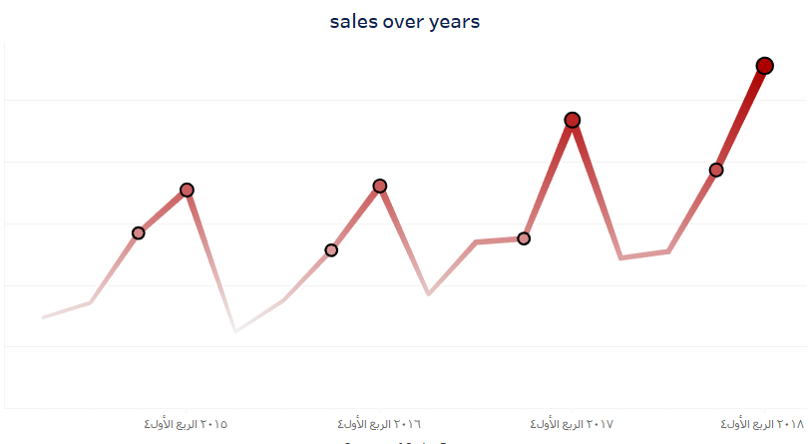
By analyzing the data, the following was concluded:
There have been changes in sales over the years as:
There has been a steady increase in sales over the years.
There has also been an increase in the number of orders.
We concluded that there is a direct relationship between the increase in the number of orders and the increase in the sales price.
2018, especially the third and fourth quarters, is the period that witnessed the highest growth in sales.
2016 was generally the period with the lowest sales rate, while the period with the largest decline in sales was the first quarter of 2015.
In general, the first and second quarters of each year have the lowest purchasing rate (Office Supplies , Technology products , and furniture) due to the severity of the winter frost and the end of the Financial year.
Sales begin to increase starting from the third quarter and then the fourth quarter due to the start of the school year and the beginning of a new Financial year.
Notes:
هناك أي تغييرات في أنماط الشراء على مدار السنوات؟ يوجد زيادة مستمرة في المبيعات على مدار السنين ، كما يوجد زيادة في عدد الطلبيات ايضا
واستنتجنا انه يوجد علاقة طرية بين زيادة عدد الطبيات وزيادة ثمن المبيعات
2018 وخاصة الربع الثالث والرابع هي الفترة الزمنية التي شهدت أعلى نمو في المبيعات
2016 بشكل عام هي الفترة الزمنية التي شهدت اقل نسبة في المبيعات ،اما اكثر فترة زمنية شهدت انخفاض بالمبيعات هو الربع الاول من سنة 2015

Slide 18
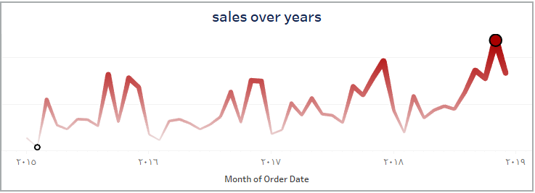
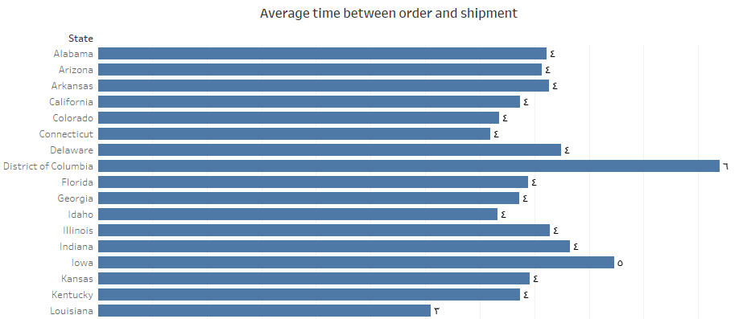
By analyzing the data, the following was concluded:
November is the month with the highest sales rates over the years,
followed by December, mostly due to the big discounts at this time and Black Friday.
February is the month with the lowest sales rates over the years, followed by January, often due to the cold weather affecting customers' ability to purchase furniture, office supplies, and electronics.
It turns out that the average time between order and shipping is 4 days. There is a state in the District of Columbia where the average shipping time is the longest, 6 days. It is the only state that does this, which has a negative impact on its sales percentage.
Notes:
شهر نوفمبر هو اعلى الشهور من حيث معدلات المبيعات خلال السنين يليه شهر ديسمبر ، وغالبا بسبب الخصومات الكبيرة في هذا الوقت والبلاك فرايدايبشكل العام الربع الاول والثاني من كل سنة يكون معدل شراء (الادوات المكتبية والالكترونية والاثاث) بهم اقل نسبة الى اشتداد السقيع بفصل الشتاء وانتهاء السنة المالية ،،،،
وتبدأ المبيعات تزيد ابتداء من الربع الثالث ثم الرابع نسبة لدخول المدراس وبداية سنة مالية جديدة
شهر فبرايرهو اقل الشهور من حيث معدلات المبيعات خلال السنين يليه شهر ديسمبر يناير، وغالبا بسبب برودة الجو فتأثر على قدرة شراء العملاء للاثاث والادوات المكتبية والالكترونيات
تبين ان متوسط الوقت بين الطلب والشحن هو ٤ ايام ، يوجد ولاية District of Columbia متوسط مدة الشحن اكبر حاجة 6 ايام وهي الولاية الوحيدة اللي كدا والذي اثر بالسلب على نسبة مبيعاتها

Slide 19
08
Conclusion &insights

Slide 20

insights
Increase marketing campaigns in the third and fourth quarters (discounts, exclusive offers, school/office packages).
زيادة وتحسين المبيعات في اول السنة
Stimulate sales in the first and second quarters through:
Beginning of the year promotions (such as discounts on stationery).
Marketing seasonal products (heating, lighting, household appliances).
Improve the supply chain for this region (local warehouses, faster shipping companies).
Offer special offers such as "free shipping" or "compensation discounts" to customers in this state.
Investigate the reasons for the delay (is it a logistical issue? a large number of orders?)
مشكلة الشحن في District of Columbia
Notes:
زيادة الحملات التسويقية في الربع الثالث والرابع (خصومات، عروض حصرية، حزم للمدارس/المكاتب).
تحفيز المبيعات في الربع الأول والثاني عبر:
عروض "بداية السنة" (مثل خصومات على الأدوات المكتبية).
تسويق منتجات موسمية (تسخين، إضاءة، أدوات منزلية).
---------------------
تحسين سلسلة التوريد لهذه المنطقة (مخازن محلية، شركات شحن أسرع).
عروض خاصة مثل "شحن مجاني" أو "خصومات تعويضية" للعملاء في هذه الولاية.
دراسة أسباب التأخير (هل هي مشكلة لوجستية؟ كثرة الطلبات؟)

Slide 21
06
Dashboard
Notes:
模板来自于：第一PPT https://www.1ppt.com/

Slide 22
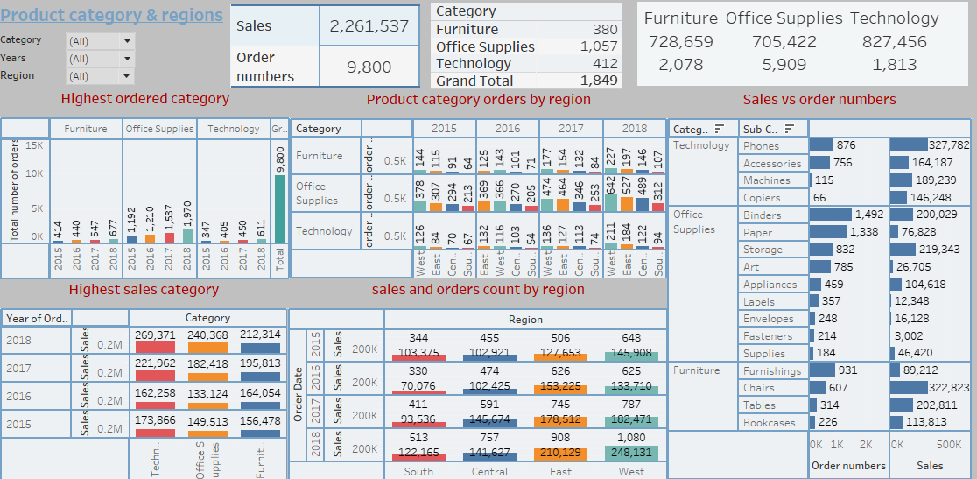

Dashboard products category and regions By Abdelrahman Shaban

Slide 23
07
Data processing &insights
Notes:
模板来自于：第一PPT https://www.1ppt.com/

Slide 24
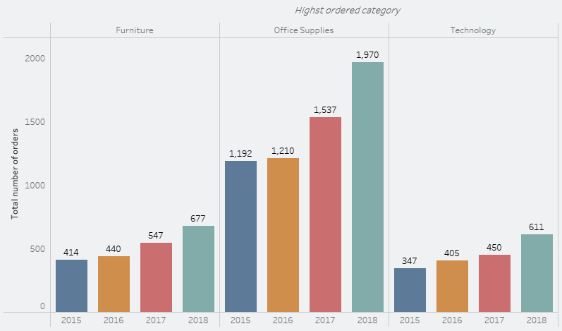
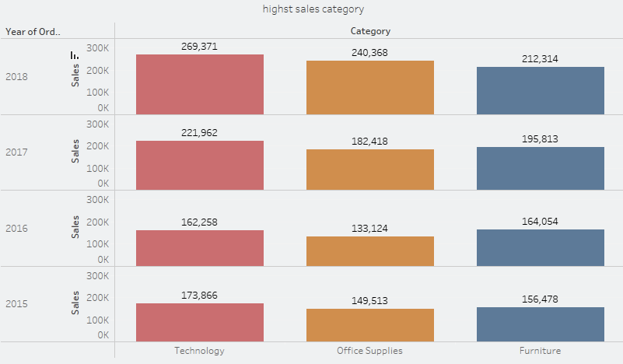
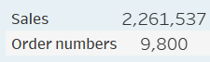
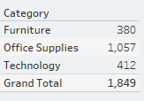
Product category and regions
Total sales is 2,261,537 total orders 9800
Total products number is 1849 item distributed on 3 main categories :
Furniture : 380 Office supplies : 1057 Tech : 412
Sales in all three categories show an increasing trend from 2016 to 2018, indicating overall business growth
The Technology category exhibits the highest sales values while Furniture sales show steady growth from 2016 onwards
Office Supplies sales decline (despite of number of orders increasing) from 2015 to 2016 but then experience significant growth in 2017 and 2018

Slide 25
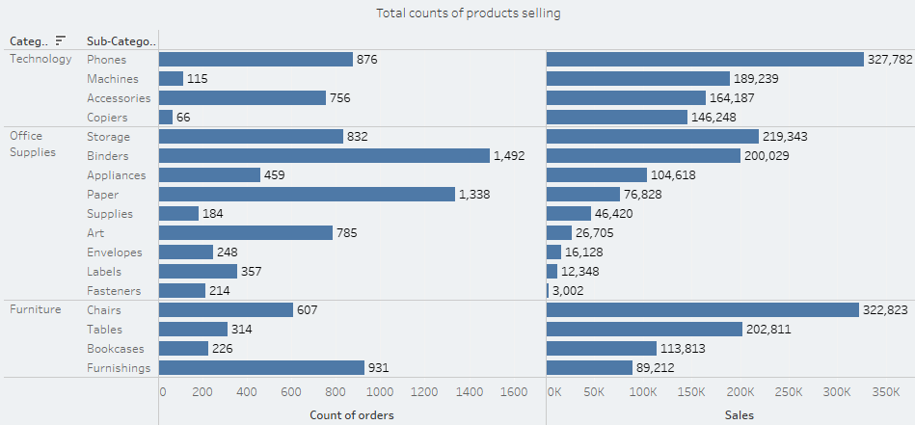
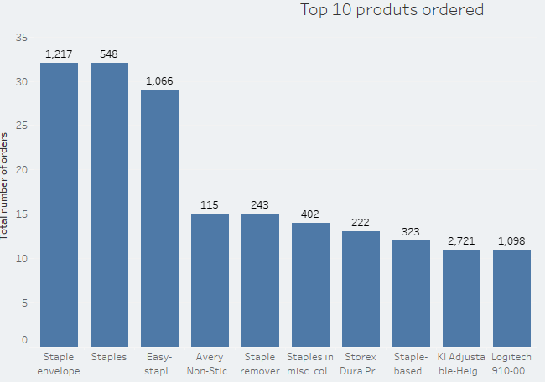
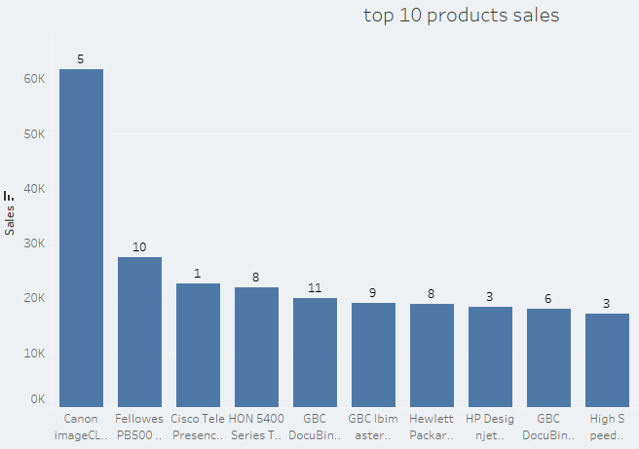
Product category and regions
Number of orders in 2016 was more than 2015 in office supplies but sales was lower that’s what charts describing >> the number of orders doesn’t reflect the amount of sales . Binders" had the highest count but lower total revenue than "Phones" and "Chairs."
Expensive technology equipment drive total sales but are purchased less frequently.
Office Supplies have the most diverse set of sub-categories, possibly indicating a broad market demand across multiple products. Technology is more focused on high-value sub-categories like Phones and Accessories, which could indicate a smaller but high-revenue market
The most frequently sold products are Staple Envelope, Staples, and Easy-Staple Paper. These products are low-cost, frequently used office supplies, indicating high demand for everyday essentials
The highest revenue-generating product is the Canon image CLASS 2200 Advanced Copier

Slide 26
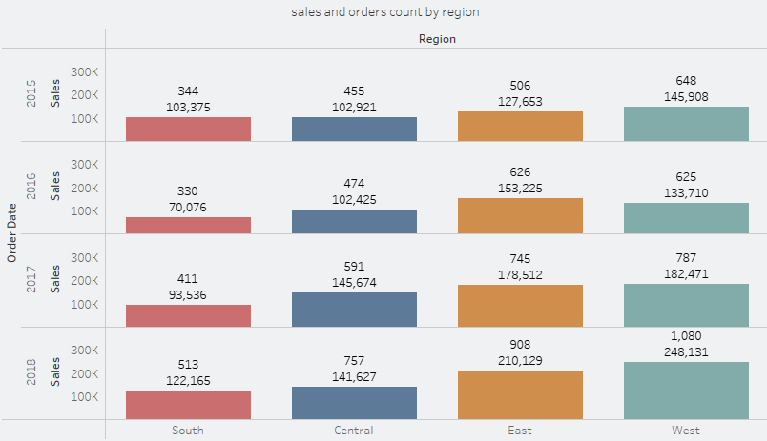
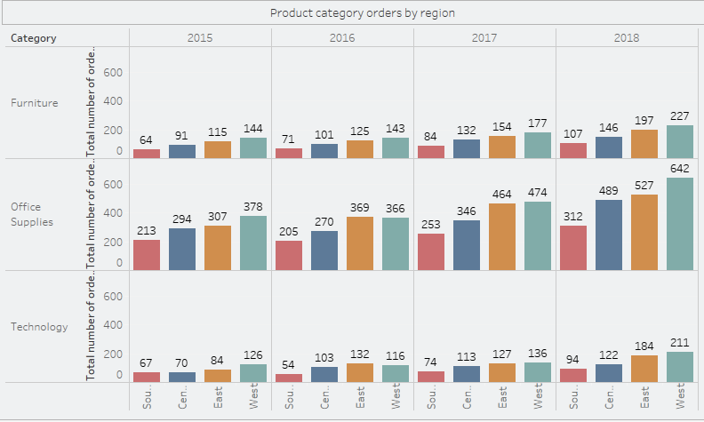
Product category and regions
The West and East regions not only have high sales totals but also a higher number of transactions.
The South region has the lowest number of transactions and the lowest total sales, indicating either fewer transactions or lower average sales per transaction.
The Central region has moderate sales and transaction counts.
This variation across regions leads to drill down to states level to know why this variation happened
Notes:
Fluctuations= تذبذب

Slide 27
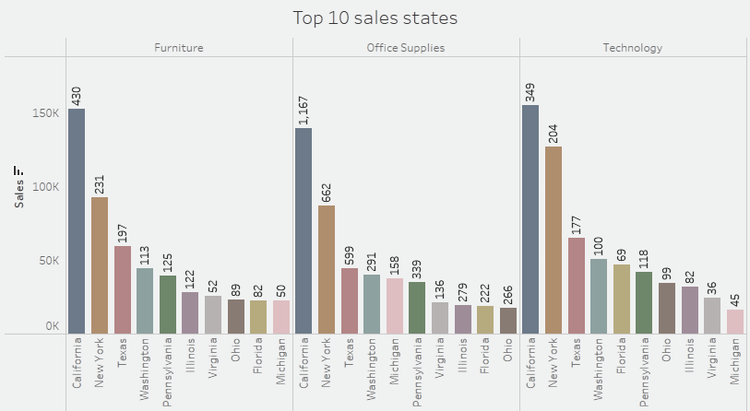
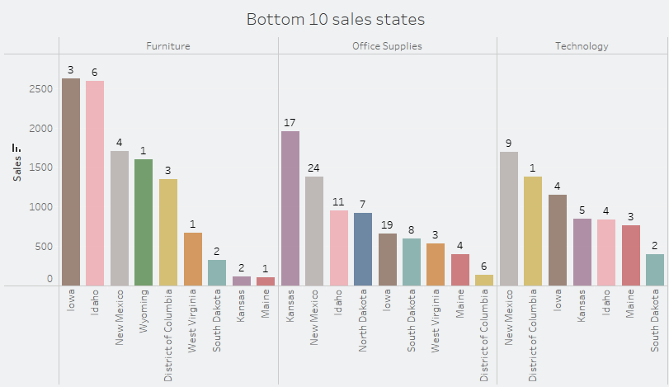
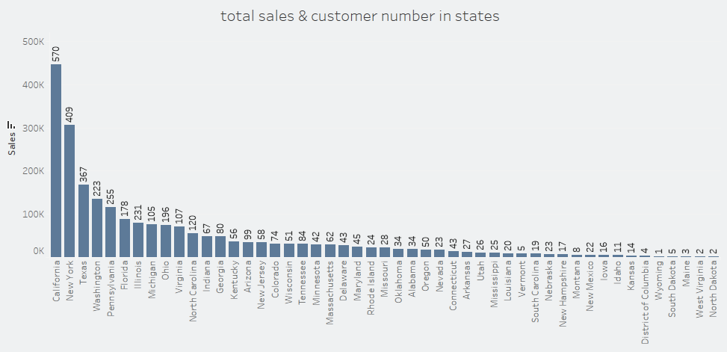
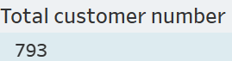
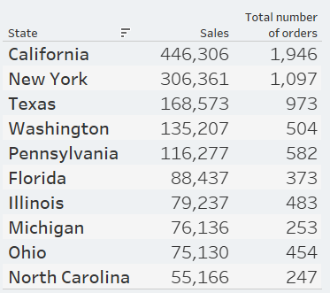
Product category and regions
California has both the highest sales and customer count, meaning a large market presence.
Washington (#4 in sales( has fewer customers than Pennsylvania (#3 in customers), meaning higher-value transactions in Washington
Florida vs Illinois indicating lower spending per customer or ordering low sales value products .
Most of top 10 states are characterized by high population , big famous crowded cities , commercial and industrial activities ,Big universities , job opportunities , high incomes . That’s emphasize there is a good market to compete in .
Most of bottom 10 states are characterized by , low population , small quite cities , isolated ,bad weather ,low facilities and services ,agriculture or fishing depending mainly .
There is quick info about some states to clear the market chances difference
Ref : united states census bureau , speed test global index , www.walkscore.com

Slide 28
Product category and regions
State | Rank | Population | Characteristics | Market chance
West Virginia | Bottom 10 | 1,769,979 | Small rural cities ,low internet speed #44 ,no opportunity for corporates or remote work | Low
Wyoming | Bottom 10 | 587,618 | Small towns ,extreme weather, high elevation, low internet speed #48 | low
Maine | Bottom 10 | 1,405,012 | Coast state with small towns ,bad weather ,isolated ,low internet speed #50 | low
North Dakota | Bottom 10 | 779,094 | Despite of being a small state but North Dakota has a job market driven by industries like energy, agriculture, healthcare, and technology. The state’s booming energy sector, particularly in oil and gas, has created a wealth of job opportunities in cities such as Bismarck and Dickinson ,high internet speed #2 | Promising
California | Top 10 | 39,431,263 | California is home to some of the most competitive and lucrative industries in the world, from Silicon Valley’s tech giants to Hollywood’s entertainment empire. Companies like Apple, Google, and Tesla set the pace for innovation, while Los Angeles is the heartbeat of film, television, and music. Agriculture, healthcare, and aerospace also play massive roles in the state’s economy, home to some of the best schools in the country, with world-renowned universities like Stanford, UCLA, and UC Berkeley leading the way. | High
Texas | Top 10 | 31,290,831 | Texas is known for its business-friendly policies, making it an appealing place for entrepreneurs and small business owners , Austin has become a major player in the tech world, attracting big names like Tesla, Apple, and Google, while Houston remains a powerhouse for energy and medical research. Dallas-Fort Worth is a prime location for corporate headquarters, finance, and manufacturing, and San Antonio is steadily growing in healthcare and military-related jobs | High
Florida | Top 10 | 23,372,215 | one of the more tax-friendly states in the U.S , mix of industries that provide opportunities in fields like aerospace, healthcare, and international trade. Cities like Tampa and Jacksonville have booming financial and tech sectors, while Orlando is home to major corporations in entertainment and simulation technology | High
Pennsylvania | Top10 | 13,078,751 | Pennsylvania has top-tier universities like the Ivy League’s University of Pennsylvania, the tech-driven Carnegie Mellon University. | high

Slide 29
08
Conclusion

Slide 30
Product category and regions
Conclusion & recommendation
1. Focus on High-Selling States for Immediate Gains:
these states should remain the primary focus for marketing and sales efforts
These states have larger populations and urban centers, leading to more potential customers.
Technology is the highest-selling category, and these states likely have a high demand for tech products due to their urban populations, businesses, and consumers with high income
in high-selling states:
Targeted Digital Marketing: digital marketing campaigns (Google Ads, Facebook Ads, Instagram, etc.) for technology products and high revenue furniture products, especially in large cities in these states.
Optimize Inventory for Technology: Ensure a large, diverse inventory of tech products, as this category is driving most of the sales.
Cross marketing : use the large number of customers ordering office supplies to market for technology products
2. Optimize for Office Supplies Sales:
Even though Office Supplies generates a lot of orders, the revenue is low. This indicates that while there are lots of small-ticket purchases, they're not driving significant profits. This could be due to either lower prices or lower-margin items in the category.
What to do for Office Supplies:
Bundle with Technology: Offer office supply bundles with technology products, such as papers or accessories with printers. This will increase the average order value.
Special Deals and Discounts: Implement bulk discounts or promotional offers targeting businesses or home offices, particularly in high-selling states.
3. Evaluating Low-Selling States: States of low sales may be tempting to be targeted to increase sales, these areas may have limited growth potential due to factors like Lower population density ,smaller markets , Lower demand for technology products so :
Gradual Expansion: Rather than investing heavily right away, consider a gradual marketing effort in these states. Perhaps launch more localized ads and promotions targeted at small business owners or consumers
Regional Offers and Promotions: Provide incentives for customers in these areas (e.g., free shipping or special deals on bulk office supplies for businesses). However, avoid over-investing in these states unless see a clear trend of demand building. A focus on low-selling states without a substantial return could result in wasted resources.
Summarizing previous points :
Focus Resources in High-Selling States (California, Texas, etc.) for a more immediate return. Concentrate marketing, inventory, and promotions in these areas where sales are already strong.
Incorporate Regional Promotions for low-selling states, but keep the investment limited. Test the environment with specific campaigns tailored to local needs, such as office supplies or tech discounts for businesses in these regions.
Product Diversification: Continue leveraging Technology as core category but consider diversifying Office Supplies by offering premium options, exclusive items, or bundles to increase the sales value per transaction.
`

Slide 31
06
Dashboard
Notes:
模板来自于：第一PPT https://www.1ppt.com/

Slide 32
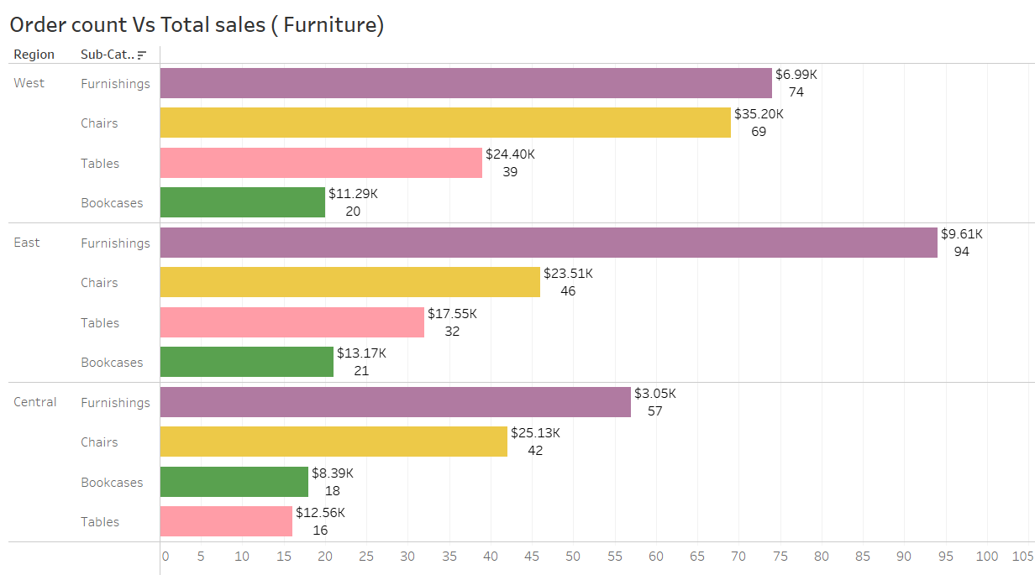
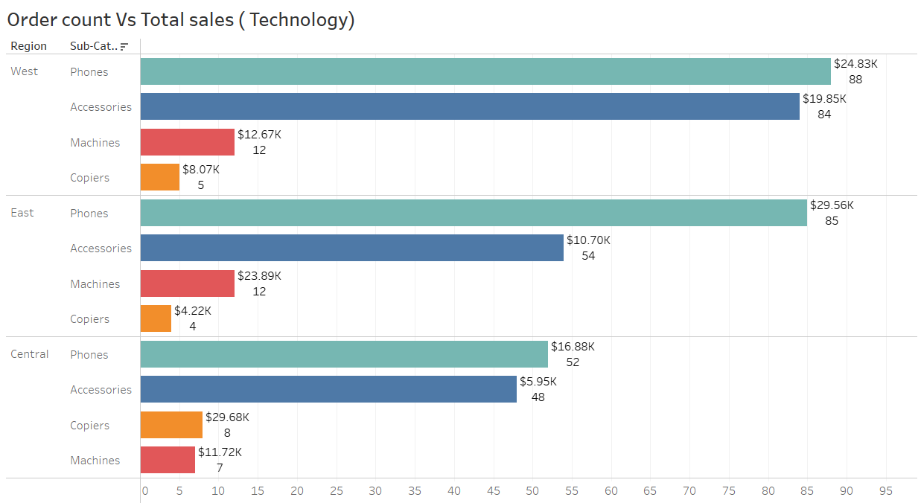
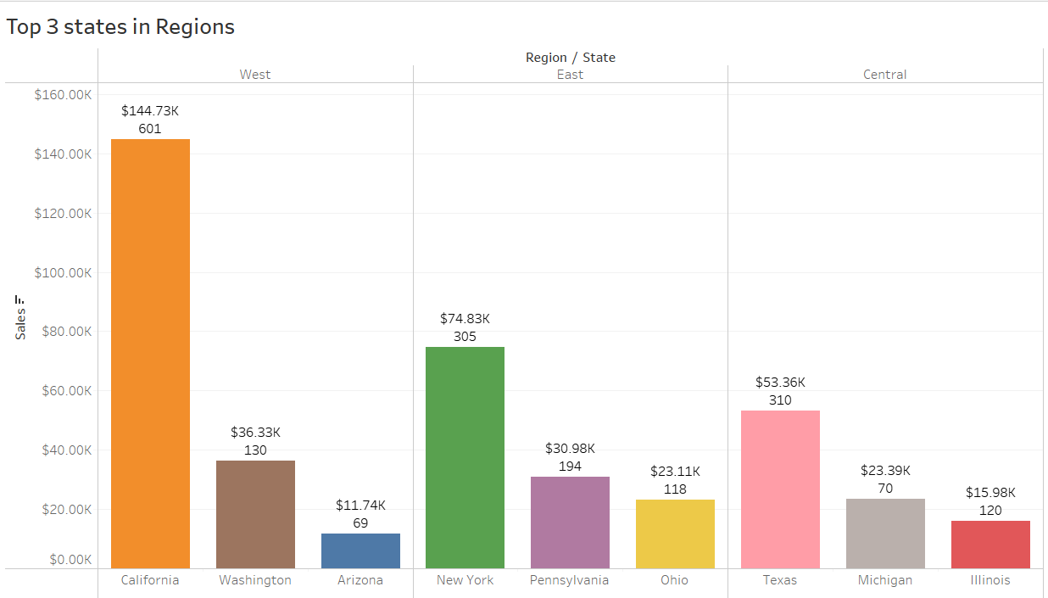
Dashboard By Mahmoud Mohamed Akl
Furniture Category Insights
Reviewing Pricing Of Furnishings and compare it to competitors
Make focused campaigns on cross selling tables with chairs and offer discounts
Making full office furniture packages specialised for new businesses and customize decoration service
----------------------------------------------------------------------------------------------------------------------------------
Technology Category Insights
Focusing on phones in marketing strategy especially in East and West regions
Making Phones to accessories packages on central Region
Study copiers market to make sure the feasibility of the market to focus on it or cancel this category

Slide 33
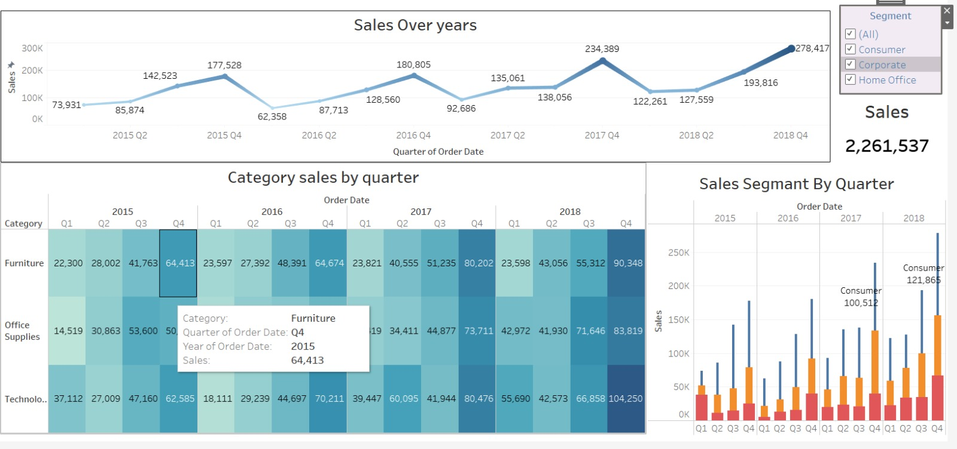
Dashboard Shipping By Ebrahim Mohamed

Slide 34
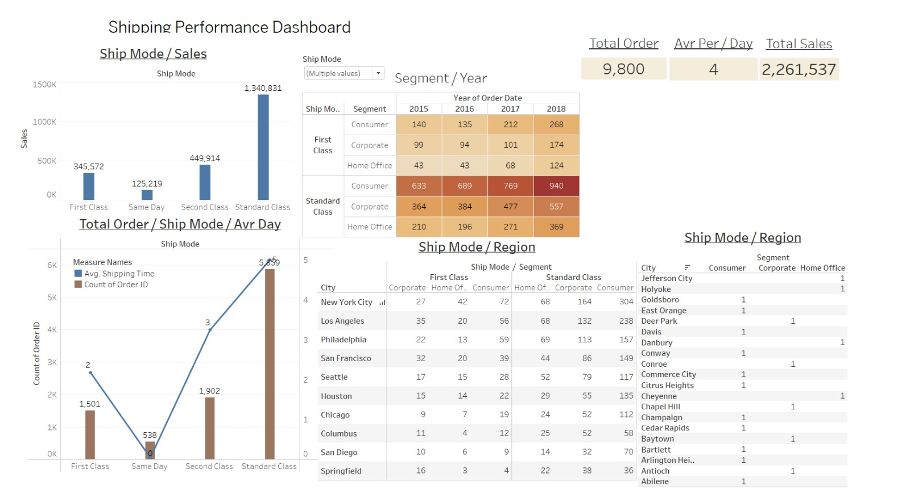
Dashboard Shipping By Osama Fathy

Slide 35
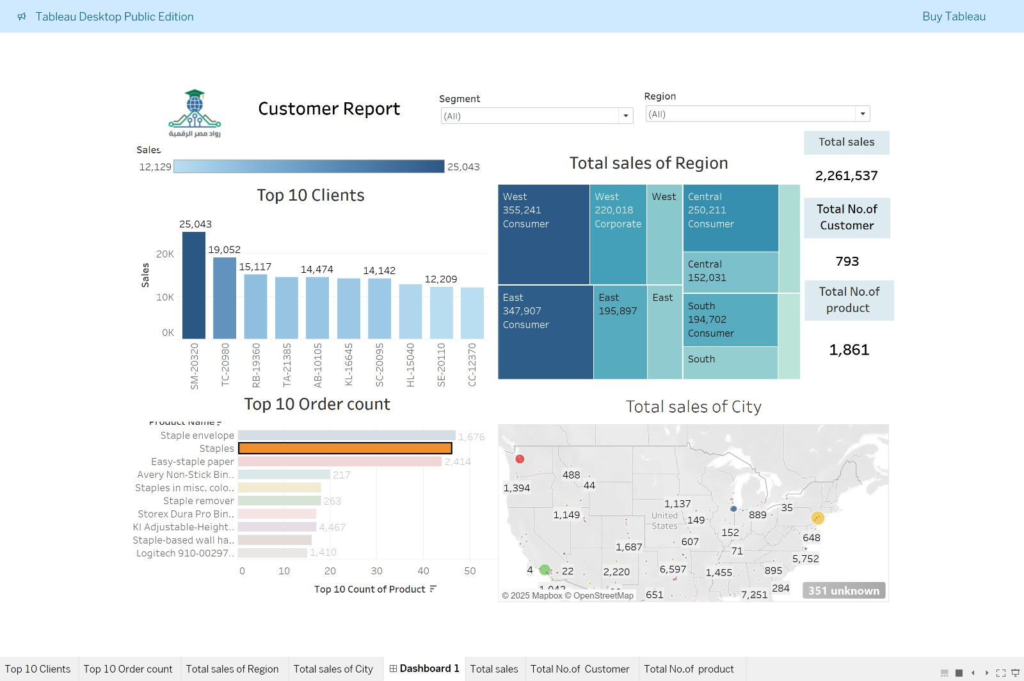
Dashboard Shipping By Mahmoud Reda

Slide 36


Any Question?
Under Supervision
Eng. Soha Nagi
Prepared by
Group 3

